Slide 1

Effect of Instance Location and Network Interface on Computational Performance of a Cluster
Arti Patel
Ashutosh Kumar

Slide 2
Goals of the project
High Performance Linpack (HPL) benchmarking on various instances.
To find the optimal problem size, run the benchmark and record the performance of the instance.
Finding the bandwidth between instances in various cases using the iPerf tool.
Finding the latency between instances in various cases using the Netperf tool.

Slide 3
Technical approach
To compile HPL Benchmark, we installed
OpenBLAS (Basic Linear Algebra Subprograms)
OpenMPI (Message Passing Interface)
To run the benchmark, we configured HPL.dat file, which contains the various variables required to run it.
Problem size (N), Block size (NB), P*Q = number of MPI processes
We experimented on AWS EC2 instances of types t2.micro and t2.xlarge, with various problem sizes.
Created 2 instances in US East (Ohio) region and 2 instances in Asia-Pacific Northeast (Tokyo) region.

Slide 4
Technical approach
Used iPerf tool to calculate the bandwidth between various instances (within the same region and across regions).
One instance needs to be the iPerf server and another needs to be the client.
Used Netperf tool to calculate the latency between various instances (within the same region and across regions).
Similar to ping.
Sent 100 packets from one instance to another to test the latency, and received a summary (Min, Max, Mean Latency).

Slide 5
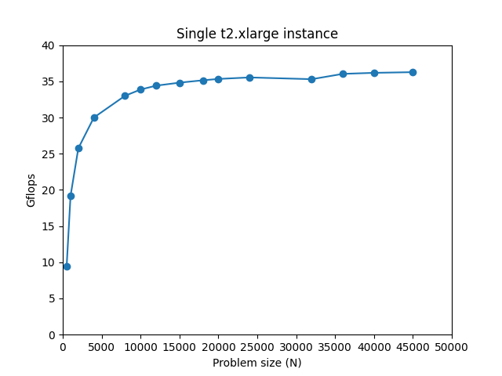
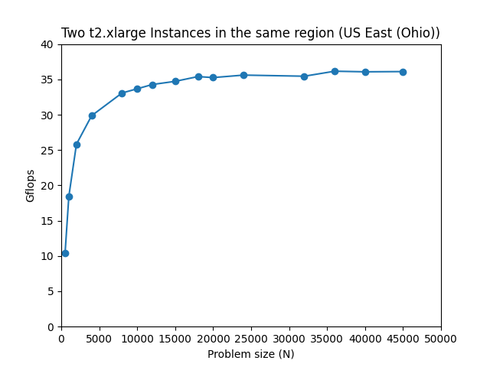
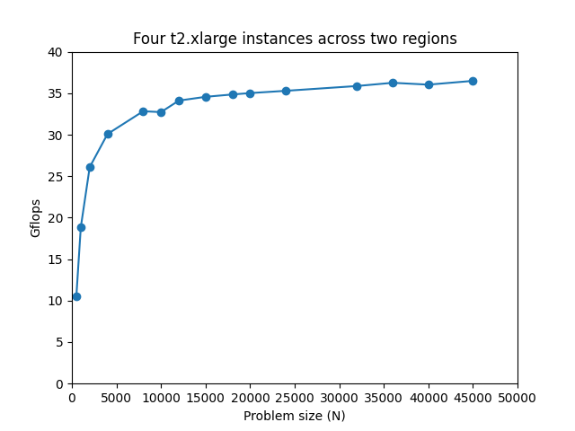
Results

Slide 6
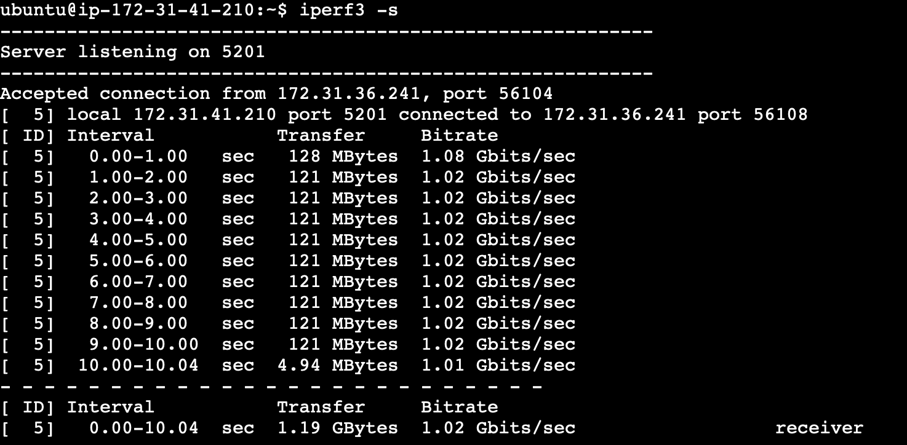
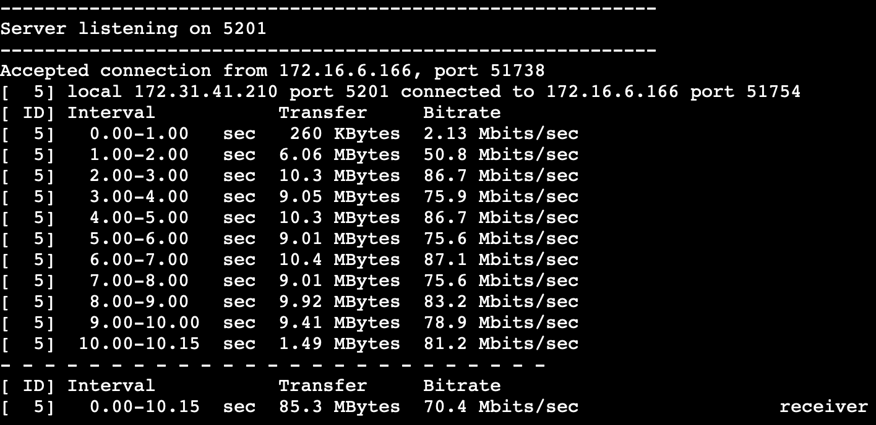
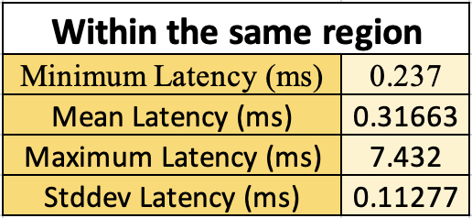
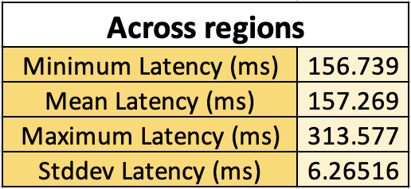
Results
iPerf bandwidth output for instances in the same region
iPerf bandwidth output for instances across regions
Netperf latency output for instances in the same region
Netperf latency output for instances across regions

Slide 7
Limitations
To experiment between instances across multiple regions using the private IP address, we need VPC peering.
Public IP addresses assigned to the instances change when the instance is started, so using private IP address is preferable.
iPerf tool does not measure the latency, so we had to use the Netperf tool.

Slide 8
Lessons Learned
For smaller problem sizes (smaller N), the Gflops value is less.
For larger problem sizes (larger N), the Gflops values are greater because of efficient use of resources and parallelization.
However, there is a ceiling that the Gflops value reach with increasing N values.
Across region, the bandwidth is much lower than within the same region (80 Mbits/s vs 1 Gbits/s).
Latency across region is much higher than within the same region (160 ms vs < 1 ms).

